Slide 1

StackStorm Architecture
Installing and Configuring StackStorm Using Quick Install
NarendraP
StackStorm: Event-Driven Automation Tool for DevOps and Infrastructure

Slide 2
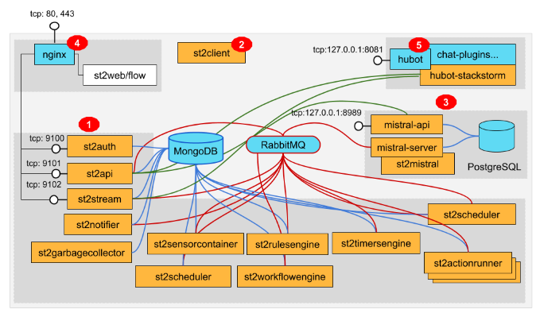
StackStorm Architecture
StackStorm Architecture Diagram:
StackStorm: Event-Driven Automation Tool for DevOps and Infrastructure

Slide 3
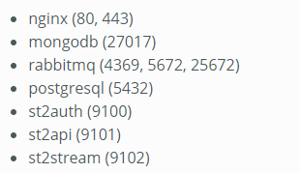
Quick Installation Steps
Quick Installation is way to Automatically Install and Configure StackStorm with a shell script on a standalone system.
But here we have one small problem.
Actually StackStorm Consist of Different Services and they are running on different ports.
Note: we need clean or fresh 64 bit Linux OS.
StackStorm: Event-Driven Automation Tool for DevOps and Infrastructure

Slide 4
Thank you

